Slide 1
Unsupervised learning

Slide 2
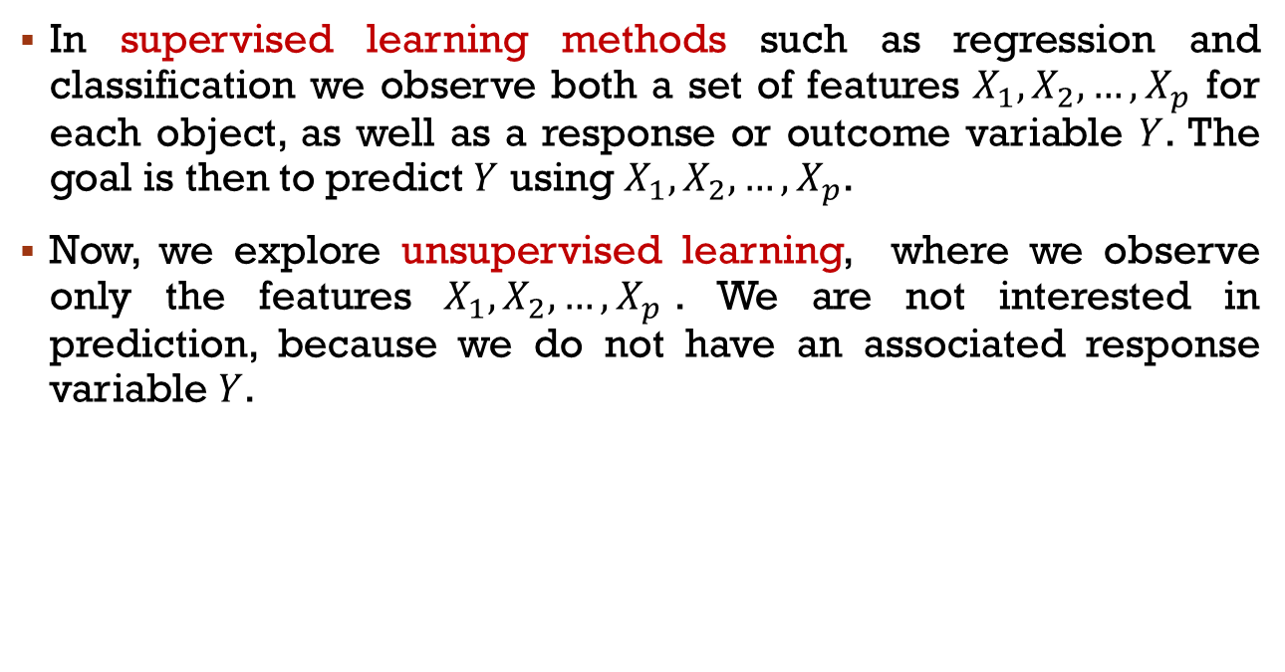
Supervised vs Unsupervised Learning
In supervised learning methods such as regression and classification we observe both a set of features $X_{1},X_{2}, …,X_{p}$ for each object, as well as a response or outcome variable $Y$. The goal is then to predict $Y$ using $X_{1},X_{2}, …,X_{p}$.
Now, we explore unsupervised learning, where we observe only the features $X_{1},X_{2}, …,X_{p}$. We are not interested in prediction, because we do not have an associated response variable $Y$.

Slide 3
The goals of unsupervised learning
The goal is statistical inference:
to discover interesting things about the measurements.
to find an informative way to visualize the data
can we discover subgroups among the variables or among the observations?

Slide 4
The challenge of unsupervised learning
Unsupervised learning is more subjective than supervised learning, as there is no simple goal for the analysis, such as prediction of a response.
But techniques for unsupervised learning are of growing importance in a number of fields:
subgroups of cancer patients grouped by their gene expression measurements,
groups of shoppers characterized by their browsing and purchase histories,
movies grouped by the ratings assigned by movie viewers.

Slide 5
Reality of unsupervised learning
It is often easier to obtain unlabeled data - from a lab instrument or a computer - than labeled data, which can require human intervention.
For example, it is difficult to automatically assess the overall sentiment of a movie review: is it favorable or not?

Slide 6
Unsupervised Learning
Unsupervised learning is important for understanding the variation and grouping structure of a set of unlabeled data, and can be a useful pre-processor for supervised learning
It is more difficult than supervised learning because there is no gold standard (like an outcome variable) and no single objective (like test set accuracy)
It is an active field of research, with many recently developed tools such as self-organizing maps, independent components analysis and spectral clustering

Slide 7
Data clustering

Slide 8
Clustering
Clustering refers to a set of techniques for finding subgroups, or clusters, in a data set
A good clustering is one when the observations within a group are similar but between groups are different
We must define what it means for two or more observations to be similar or different
Indeed, this is often a domain-specific consideration that must be made based on knowledge of the data being studied

Slide 9
Clustering for Market Segmentation
Suppose, we have access to a large number of measurements (e.g. median household income, occupation, distance from nearest urban area, and so forth) for a large number of people
Our goal is to perform market segmentation by identifying subgroups of people who might be more receptive to a particular form of advertising, or more likely to purchase a particular product
The task of performing market segmentation amounts to clustering the people in the data set

Slide 10
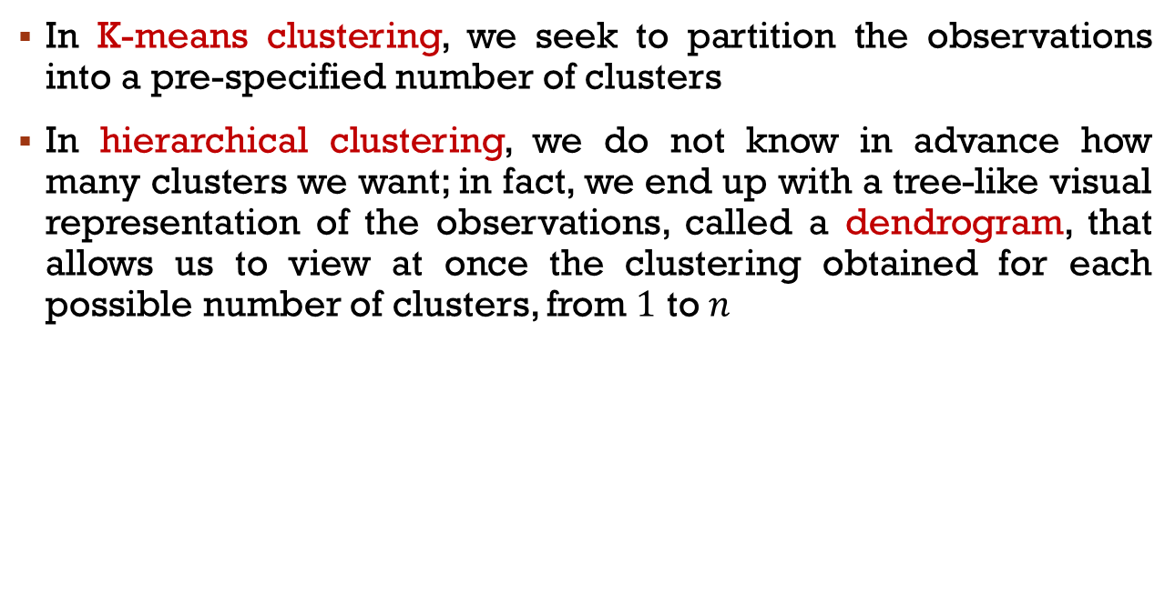
Two clustering methods
In K-means clustering, we seek to partition the observations into a pre-specified number of clusters
In hierarchical clustering, we do not know in advance how many clusters we want; in fact, we end up with a tree-like visual representation of the observations, called a dendrogram, that allows us to view at once the clustering obtained for each possible number of clusters, from $1$ to $n$

Slide 11
PCA vs Clustering
PCA looks for a low-dimensional representation of the observations that explains a good fraction of the variance
Clustering looks for homogeneous subgroups among the observations

Slide 12
K-Means clustering

Slide 13
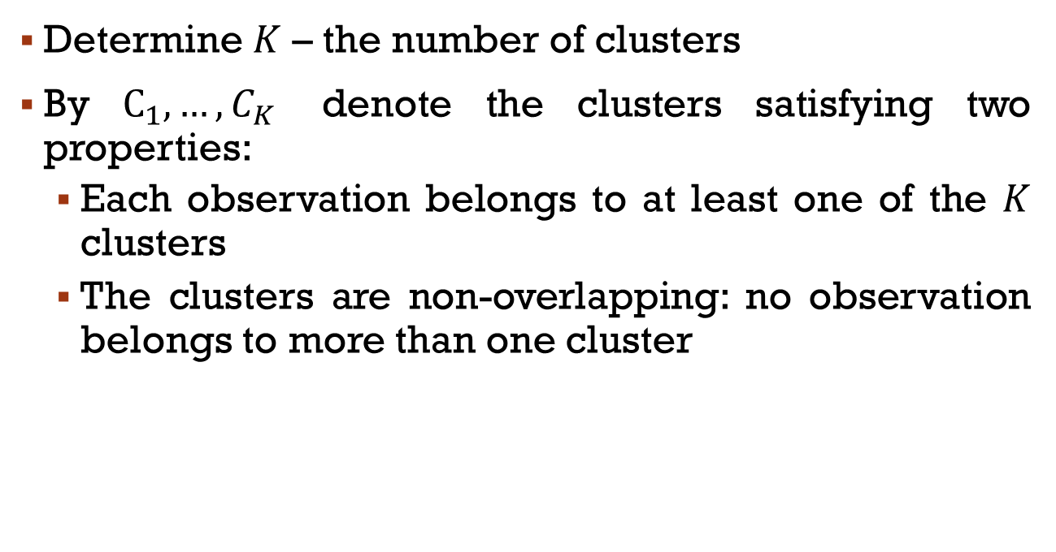
introduction
Determine $K$ – the number of clusters
By $C_{1},…,C_{K}$ denote the clusters satisfying two properties:
Each observation belongs to at least one of the $K$ clusters
The clusters are non-overlapping: no observation belongs to more than one cluster

Slide 14
example
A simulated data set with 150 observations in 2-dimensional space
K-means algorithm will assign each observation to exactly one of the K clusters

Slide 15
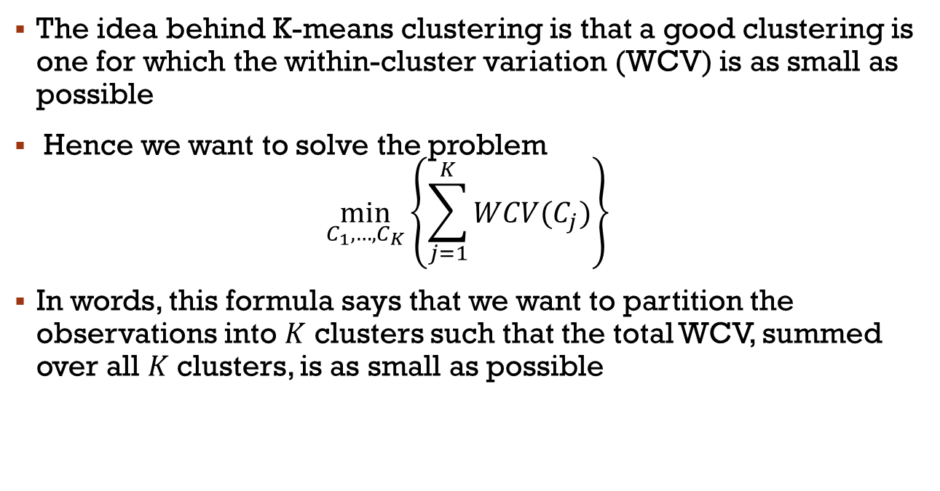
Within cluster variation
The idea behind K-means clustering is that a good clustering is one for which the within-cluster variation (WCV) is as small as possible
Hence we want to solve the problem
$$\min_{C_{1},…,C_{K}}\left\{\sum_{j=1}^{K}{WCV(C_{j})}\right\}$$
In words, this formula says that we want to partition the observations into $K$ clusters such that the total WCV, summed over all $K$ clusters, is as small as possible

Slide 16
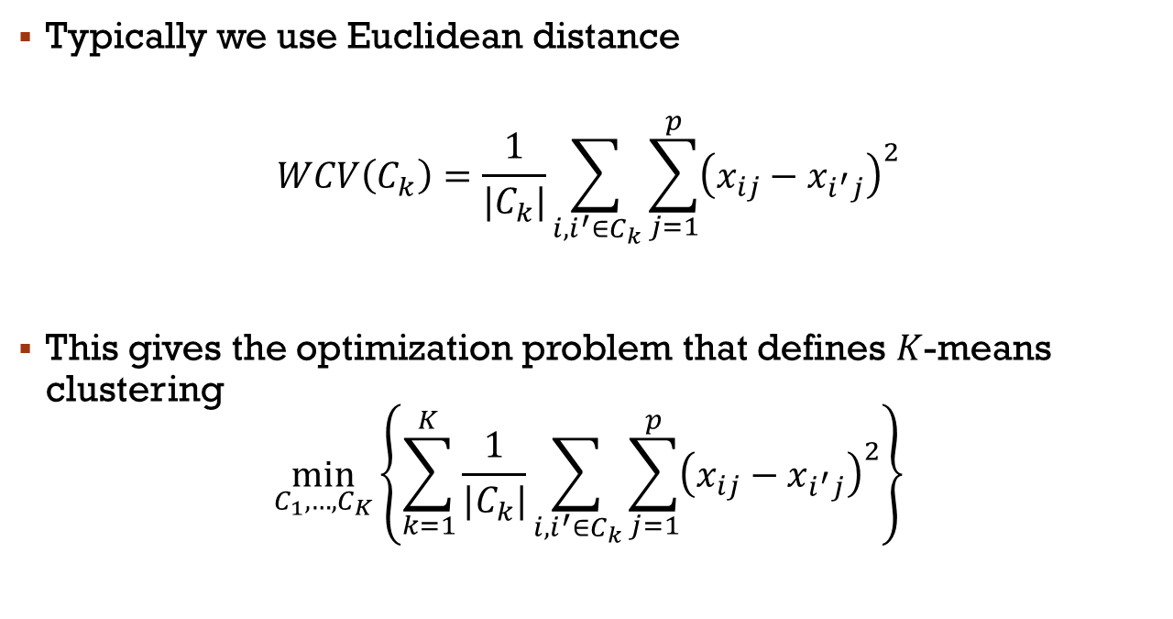
within-cluster variation
Typically we use Euclidean distance
$$WCV\left(C_{k}\right)=\frac{1}{|C_{k}|}\sum_{i,i^{′}∈C_{k}}{\sum_{j=1}^{p}{{\left(x_{ij}−x_{i^{′}j}\right)}^{2}}}$$
This gives the optimization problem that defines $K$-means clustering
$$\min_{C_{1},…,C_{K}}\left\{\sum_{k=1}^{K}{\frac{1}{|C_{k}|}\sum_{i,i^{′}∈C_{k}}{\sum_{j=1}^{p}{{\left(x_{ij}−x_{i^{′}j}\right)}^{2}}}}\right\}$$

Slide 17
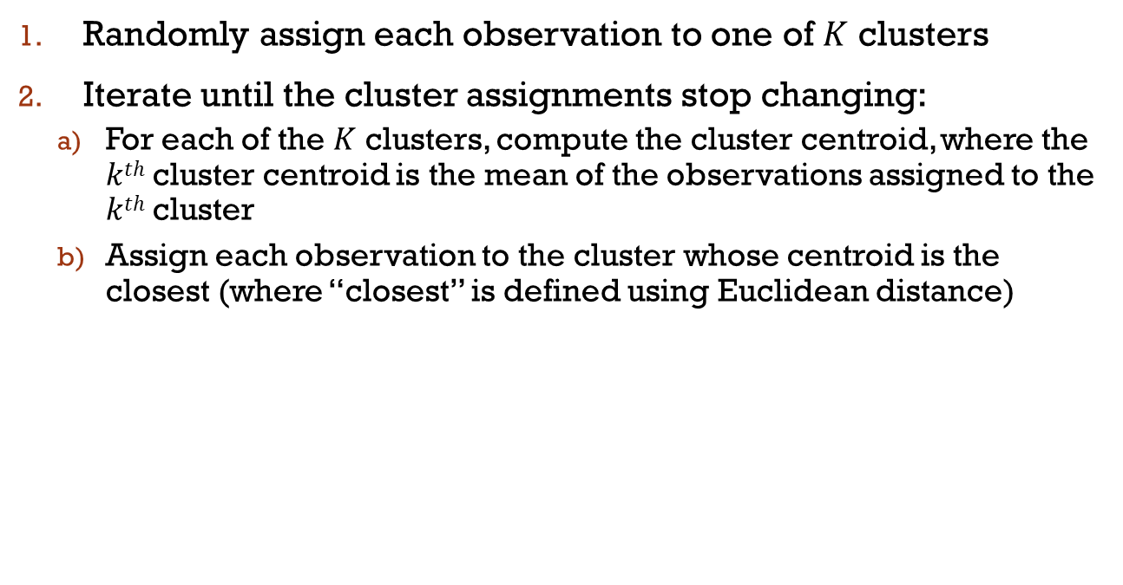
K-Means Algorithm
Randomly assign each observation to one of $K$ clusters
Iterate until the cluster assignments stop changing:
For each of the $K$ clusters, compute the cluster centroid, where the $kth$ cluster centroid is the mean of the observations assigned to the $kth$ cluster
Assign each observation to the cluster whose centroid is the closest (where “closest” is defined using Euclidean distance)

Slide 18
K-means algorithm
However it is not guaranteed to give the global minimum
When the result no longer changes, a local optimum has been reached
The results obtained will depend on the initial (random) cluster assignment of each observation in the initial step
For this reason, it is important to run the algorithm multiple times from different random initial configurations
Then one selects the best solution, i.e. that for which the objective is the smallest

Slide 19
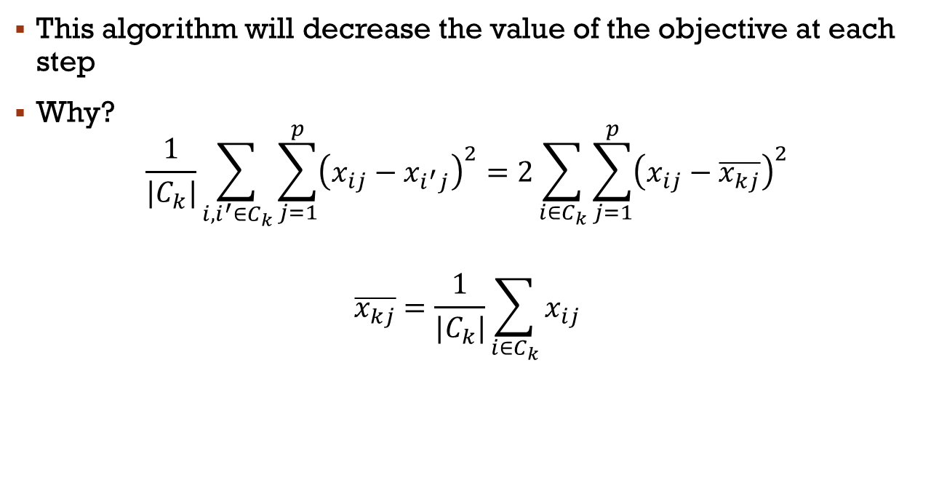
K-Means Algorithm
This algorithm will decrease the value of the objective at each step
Why?
$$\frac{1}{|C_{k}|}\sum_{i,i^{′}∈C_{k}}{\sum_{j=1}^{p}{{\left(x_{ij}−x_{i^{′}j}\right)}^{2}}}=2\sum_{i∈C_{k}}{\sum_{j=1}^{p}{{\left(x_{ij}−\overline{x_{kj}}\right)}^{2}}}$$
$$\overline{x_{kj}}=\frac{1}{|C_{k}|}\sum_{i∈C_{k}}{x_{ij}}$$

Slide 20
An Illustration: K=3
Compute cluster centers from initial assignments
Random Assignment
Compute new cluster centers
Assign points to closest cluster center
Now there is no further change so stop

Slide 21
Local Optimums: Different starting values
Bad Solution
Good Solution
K-means clustering performed six times on the data from previous figure with K = 3, each time with a different random assignment of the observations.
Above each plot is the value of the objective.
Three different local optima were obtained, one of which resulted in a smaller value of the objective and provides better separation between the clusters.
Those labeled in red all achieved the same best solution, with an objective value of 235.8.

Slide 22
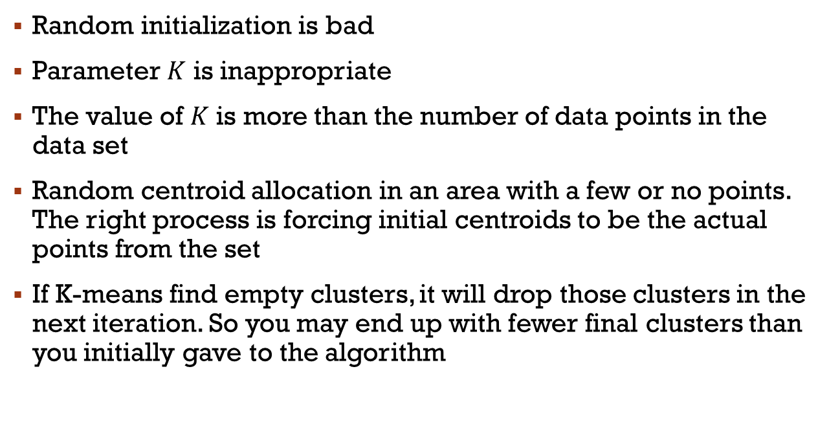
Empty Cluster in K-means
Random initialization is bad
Parameter $K$ is inappropriate
The value of $K$ is more than the number of data points in the data set
Random centroid allocation in an area with a few or no points. The right process is forcing initial centroids to be the actual points from the set
If K-means find empty clusters, it will drop those clusters in the next iteration. So you may end up with fewer final clusters than you initially gave to the algorithm

Slide 23
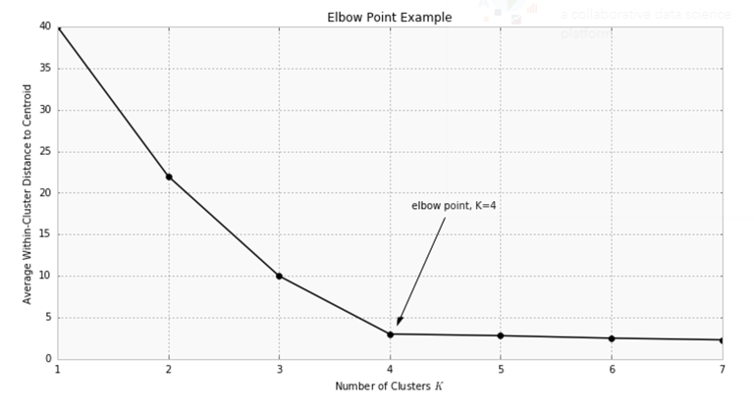
Elbow method for K selection

